Slide 1
Semi-supervised Learning
Lectured by Shangsong Liang
Sun Yat-sen University
Produced by Gholamreza Haffari
Simon Fraser University,
School of Computing Science

Slide 2
Outline
Introduction to Semi-Supervised Learning (SSL)
Classifier based methods
  EM
  Stable mixing of Complete and Incomplete Information
  Co-Training, Yarowsky
Data based methods
  Manifold Regularization
  Harmonic Mixtures
  Information Regularization
SSL for Structured Prediction
Conclusion

Slide 3
Outline of the talk
Introduction to Semi-Supervised Learning (SSL)
Classifier based methods
  EM
  Stable mixing of Complete and Incomplete Information
  Co-Training, Yarowsky
Data based methods
  Manifold Regularization
  Harmonic Mixtures
  Information Regularization
SSL for structured Prediction
Conclusion

Slide 4
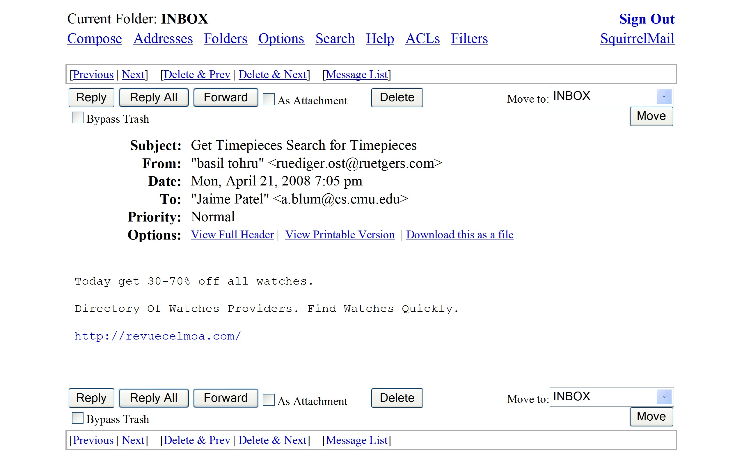
Semi-Supervised Learning
Supervised Learning = learning from labeled data. Dominant paradigm in Machine Learning.
E.g, say you want to train an email classifier to distinguish spam from important messages

Slide 5


Semi-Supervised Learning
Supervised Learning = learning from labeled data. Dominant paradigm in Machine Learning.
E.g, say you want to train an email classifier to distinguish spam from important messages
Take sample S of data, labeled according to whether they were/weren’t spam.

Slide 6
Semi-Supervised Learning
Supervised Learning = learning from labeled data. Dominant paradigm in Machine Learning.
E.g, say you want to train an email classifier to distinguish spam from important messages
Take sample S of data, labeled according to whether they were/weren’t spam.
Train a classifier (like SVM, decision tree, etc) on S. Make sure it’s not overfitting.
Use to classify new emails.

Slide 7
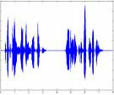

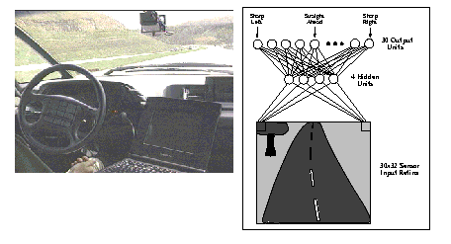
Basic paradigm has many successes
recognize speech,
steer a car,
classify documents
classify proteins
recognizing faces, objects in images
...

Slide 8
However, for many problems, labeled data can be rare or expensive.
Unlabeled data is much cheaper.
Need to pay someone to do it, requires special testing,…

Slide 9
However, for many problems, labeled data can be rare or expensive.
Unlabeled data is much cheaper.
Need to pay someone to do it, requires special testing,…
Speech
Images
Medical outcomes
Customer modeling
Protein sequences
Web pages

Slide 10
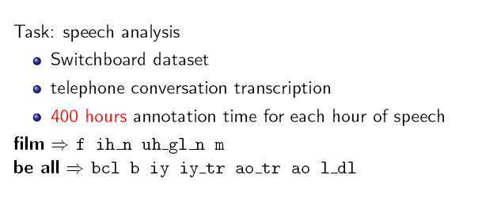
However, for many problems, labeled data can be rare or expensive.
Unlabeled data is much cheaper.
Need to pay someone to do it, requires special testing,…
[From Jerry Zhu]

Slide 11
However, for many problems, labeled data can be rare or expensive.
Unlabeled data is much cheaper.
Can we make use of cheap unlabeled data?
Need to pay someone to do it, requires special testing,…

Slide 12
Learning Problems
Supervised learning:
  Given a sample consisting of object-label pairs (x_{i},y_{i}), find the predictive relationship between objects and labels.
Un-supervised learning:
  Given a sample consisting of only objects, look for interesting structures in the data, and group similar objects.
What is Semi-supervised learning?
  Supervised learning + Additional unlabeled data
  Unsupervised learning + Additional labeled data

Slide 13


Semi-Supervised Learning
Can we use unlabeled data to augment a small labeled sample to improve learning?
But unlabeled data is missing the most important info!!
But maybe still has useful regularities that we can use.
But…
But…
But…

Slide 14
Semi-Supervised Learning
Substantial recent work in ML. A number of interesting methods have been developed.
This lecture:
Discuss several diverse methods for taking advantage of unlabeled data.
General framework to understand when unlabeled data can help, and make sense of what’s going on.

Slide 15
Motivation for SSL (Belkin & Niyogi)
Pragmatic:
  Unlabeled data is cheap to collect.
  Example: Classifying web pages,
    There are some annotated web pages.
    A huge amount of un-annotated pages is easily available by crawling the web.
Philosophical:
  The brain can exploit unlabeled data.

Slide 16
Intuition
+
_
+
_
+
_
+
_
+
_
+
_
SVM
(Balcan)
Labeled data only
Transductive SVM
Notes:
Make sure to specify what margin is!!!

Slide 17
Inductive vs.Transductive
Transductive: Produce label only for the available unlabeled data.
  The output of the method is not a classifier.
Inductive: Not only produce label for unlabeled data, but also produce a classifier.

Slide 18
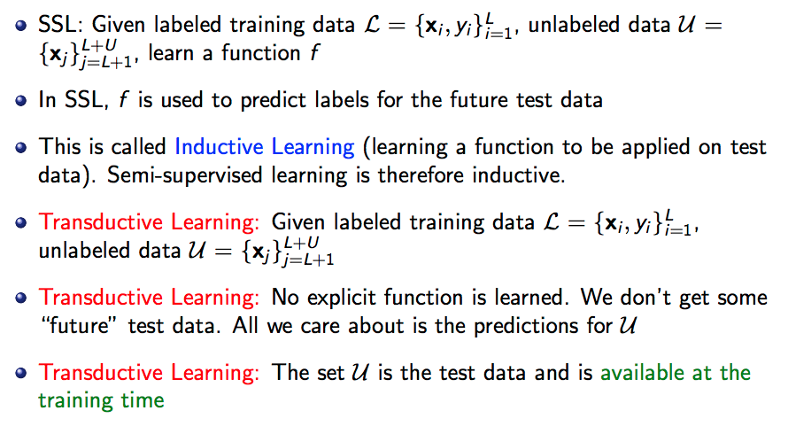

Slide 19
Two Algorithmic Approaches
Classifier based methods:
  Start from initial classifier(s), and iteratively enhance it (them)
Data based methods:
  Discover an inherent geometry in the data, and exploit it in finding a good classifier.

Slide 20
Outline of the talk
Introduction to Semi-Supervised Learning (SSL)
Classifier based methods
  EM
  Stable mixing of Complete and Incomplete Information
  Co-Training, Yarowsky
Data based methods
  Manifold Regularization
  Harmonic Mixtures
  Information Regularization
SSL for structured Prediction
Conclusion

Slide 21
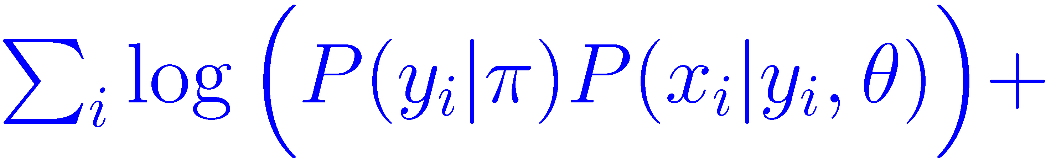

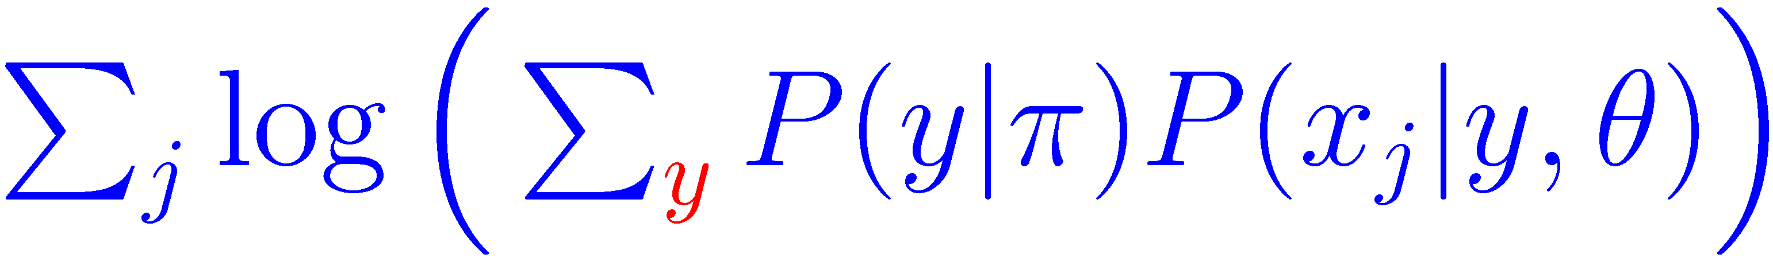
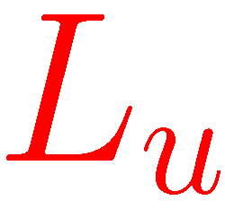
EM
(Dempster et al 1977)
Use EM to maximize the joint log-likelihood of labeled and unlabeled data:
: Log-likelihood of labeled data
: Log-likelihood of unlabeled data

Slide 22

Stable Mixing of Information
(Corduneanu 2002)
Use λ to combine the log-likelihood of labeled and unlabeled data in an optimal way:
EM can be adapted to optimize it.
Additional step for determining the best value for λ.

Slide 23

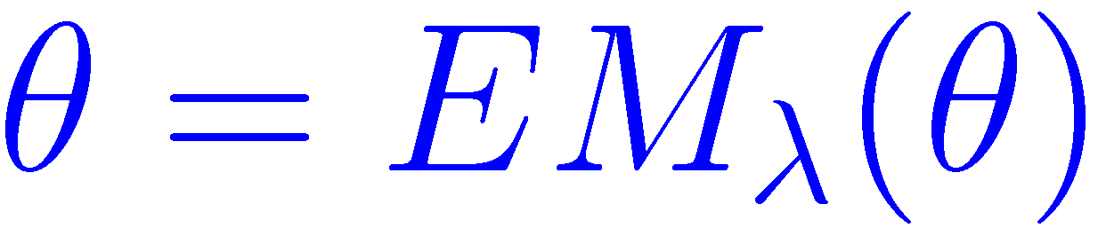
EM_{λ} Operator
E and M steps update the value of the parameters for an objective function with particular value of λ.
Name these two steps together as EM_{λ} operator:
The optimal value of the parameters is a fixed point of the EM_{λ} operator:

Slide 24
Path of solutions
θ
θ
0
λ
1
0
λ
1
How to choose the best λ ?
  By finding the path of optimal solutions as a function of λ
    Choosing the first λ where a bifurcation or discontinuity occurs; after such points labeled data may not have an influence on the solution.
  By cross-validation on a held out set. (Nigam et al 2000)

Slide 25
Outline of the talk
Introduction to Semi-Supervised Learning (SSL)
Classifier based methods
  EM
  Stable mixing of Complete and Incomplete Information
  Co-Training, Yarowsky
Data based methods
  Manifold Regularization
  Harmonic Mixtures
  Information Regularization
SSL for structured Prediction
Conclusion

Slide 26
The Yarowsky Algorithm
(Yarowsky 1995)
Iteration: 0
Iteration: 1
Iteration: 2
+
+
+
Choose instances labeled with high confidence
A
Classifier
trained
by SL
……
Add them to the
pool of current labeled training data
-
-
-

Slide 27
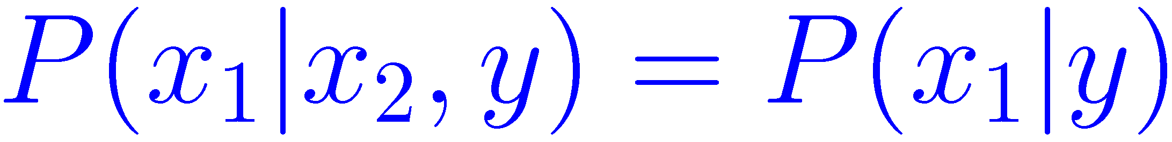
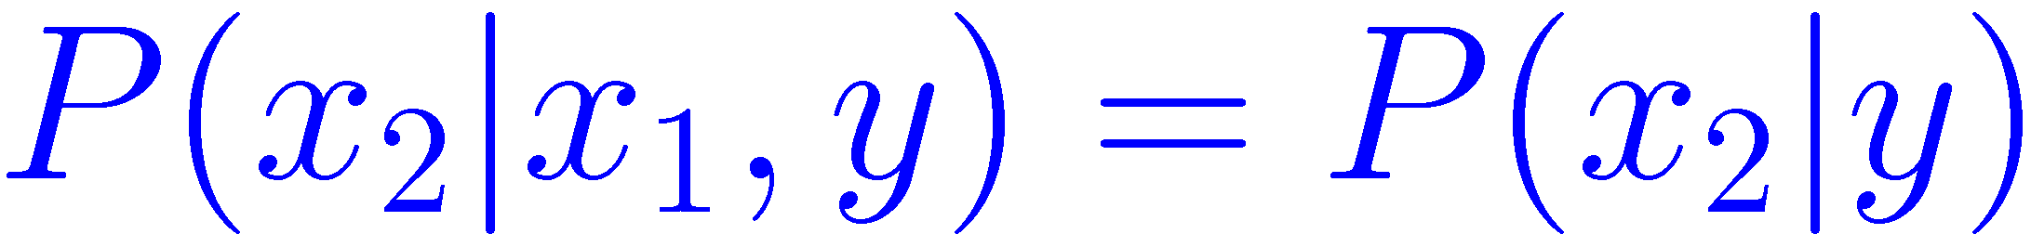
Co-Training
(Blum and Mitchell 1998)
Instances contain two sufficient sets of features
  i.e. an instance is x=(x₁,x₂)
  Each set of features is called a View
Two views are independent given the label:
Two views are consistent:
x
x₁
x₂

Slide 28
Co-Training
Allow C1 to label
Some instances
Iteration: t
Iteration: t+1
+
C1: A
Classifier
trained
on view 1
+
Add self-labeled
instances to the pool
of training data
……
C2: A
Classifier
trained
on view 2
-
-
Allow C2 to label
Some instances

Slide 29
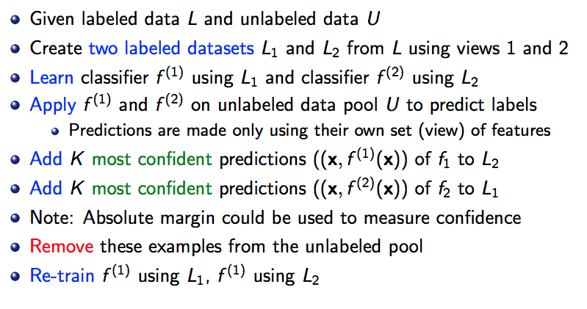

Slide 30
Agreement Maximization
(Leskes 2005)
A side effect of the Co-Training: Agreement between two views.
Is it possible to pose agreement as the explicit goal?
  Yes. The resulting algorithm: Agreement Boost

Slide 31
S³VM [Joachims98]
Suppose we believe target separator goes through low density regions of the space/large margin.
Aim for separator with large margin wrt labeled and unlabeled data. (L+U)
+
_
+
_
+
_
+
_
+
_
+
_
SVM
Labeled data only
S^3VM

Slide 32
S³VM [Joachims98]
Suppose we believe target separator goes through low density regions of the space/large margin.
Aim for separator with large margin wrt labeled and unlabeled data. (L+U)
Unfortunately, optimization problem is now NP-hard. Algorithm instead does local optimization.
  Start with large margin over labeled data. Induces labels on U.
  Then try flipping labels in greedy fashion.
+
_
+
+
_
_
+
+
+
_
_
_

Slide 33
S³VM [Joachims98]
Suppose we believe target separator goes through low density regions of the space/large margin.
Aim for separator with large margin wrt labeled and unlabeled data. (L+U)
Unfortunately, optimization problem is now NP-hard. Algorithm instead does local optimization.
  Or, branch-and-bound, other methods (Chapelle etal06)
Quite successful on text data.
+
_
+
+
_
_
+
+
+
_
_
_

Slide 34
Outline of the talk
Introduction to Semi-Supervised Learning (SSL)
Classifier based methods
  EM
  Stable mixing of Complete and Incomplete Information
  Co-Training, Yarowsky
Data based methods
  Manifold Regularization
  Harmonic Mixtures
  Information Regularization
SSL for structured Prediction
Conclusion

Slide 35
Data Manifold
+
-
?
What is the label?
Knowing the geometry affects the answer.
  Geometry changes the notion of similarity.
  Assumption: Data is distributed on some low dimensional manifold.
Unlabeled data is used to estimate the geometry.

Slide 36
Smoothness assumption
Desired functions are smooth with respect to the underlying geometry.
  Functions of interest do not vary much in high density regions or clusters.
    Example: The constant function is very smooth, however it has to respect the labeled data.
The probabilistic version:
  Conditional distributions P(y|x) should be smooth with respect to the marginal P(x).
    Example: In a two class problem P(y=1|x) and P(y=2|x) do not vary much in clusters.

Slide 37
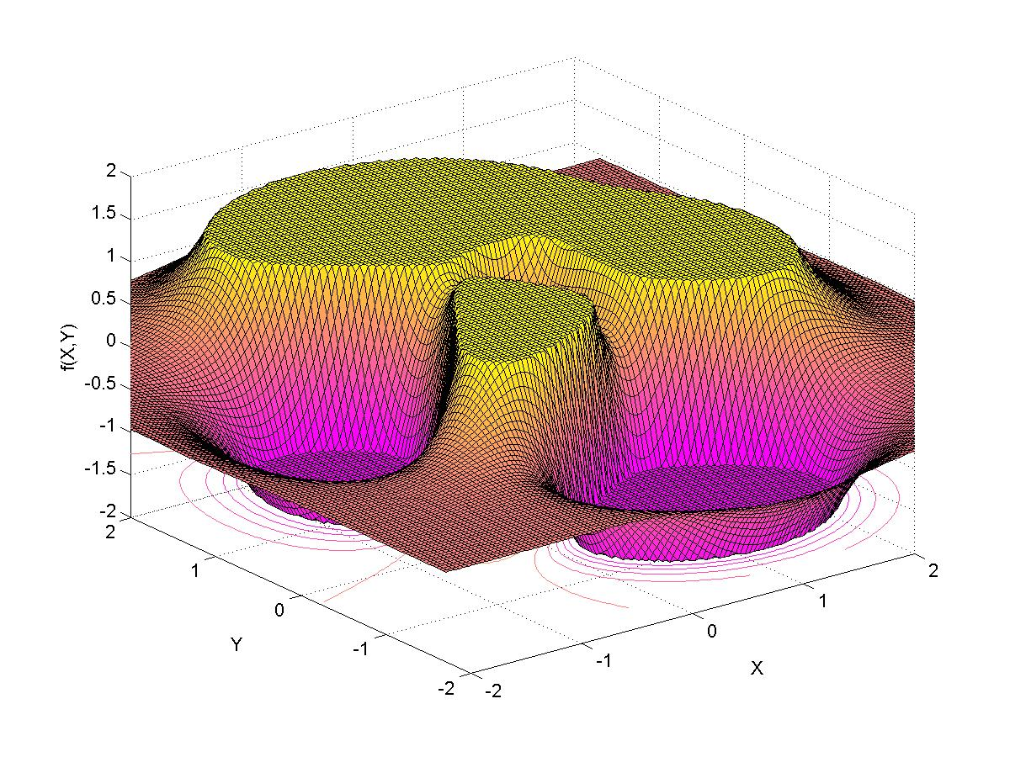
A Smooth Function
The decision
boundary
Cluster assumption: Put the decision boundary in low density area.
  A consequence of the smoothness assumption.

Slide 38
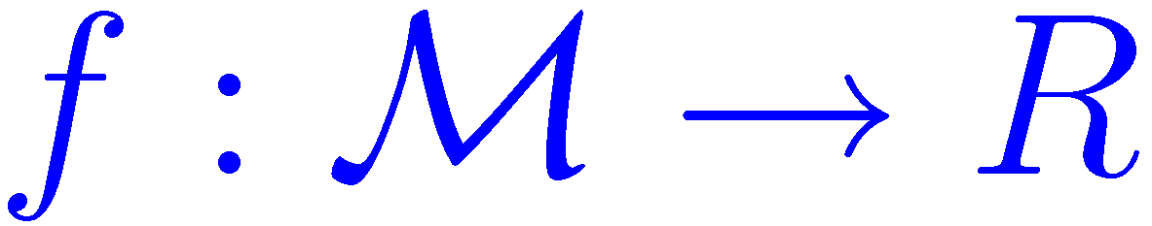


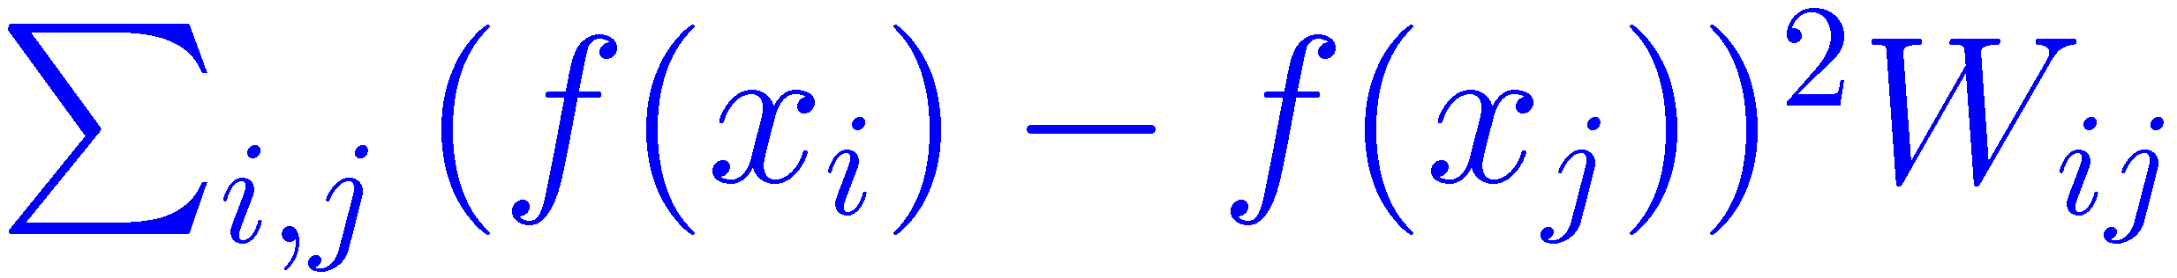
What is smooth? (Belkin&Niyogi)
Let . Penalty at :
Total penalty:
p(x) is unknown, so the above quantity is estimated by the help of unlabeled data:
W
(Krishnapuram)

Slide 39
Manifold Regularization
(Belkin et al 2004)
Data dependent
regularization
Smoothness term:
Unlabeled data
Function complexity:
Prior belief
Fitness to
Labeled data
Where:
  H is the RKHS (Reproducing Kernal Hilbert Space) associated with kernel k(.,.)
  Combinatorial laplacian can be used for smoothness term:

Slide 40
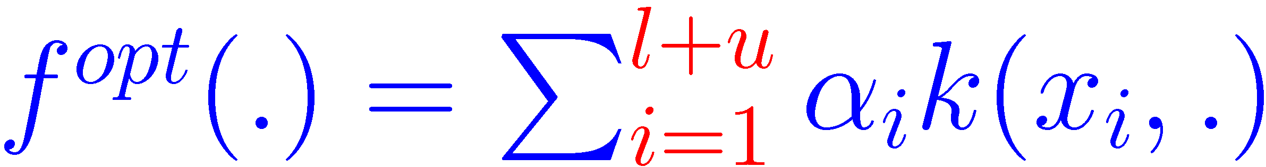
The Representer Theorem
The Representer theorem guarantees the following form for the solution of the optimization problem:
Return to SSL for structured…

Slide 41
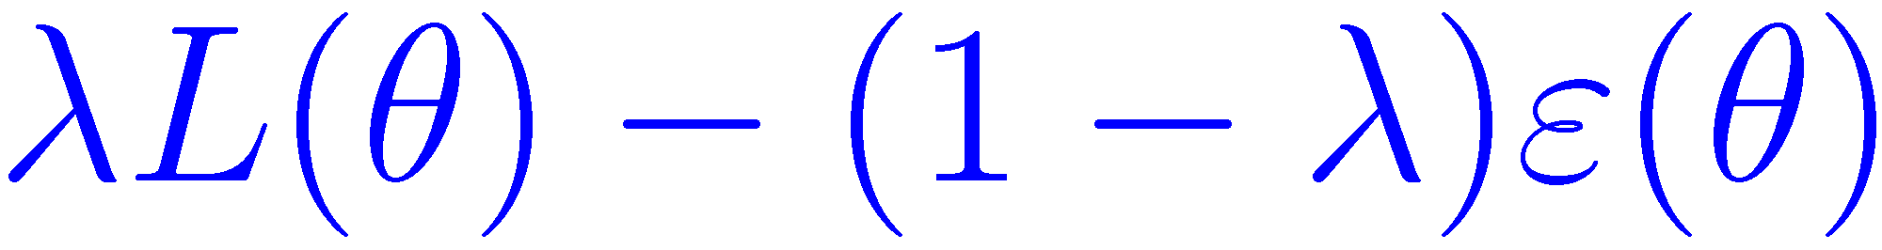

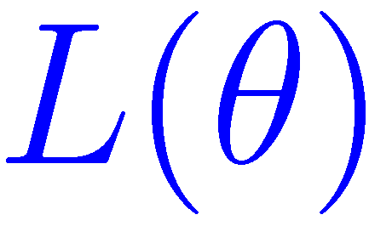
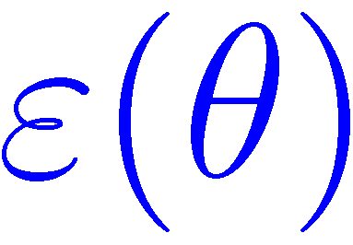
Harmonic Mixtures
(Zhu and Lafferty 2005)
Data is modeled by a mixture of Gaussians.
  Assumption: Look at the mean of Gaussian components, they are distributed on a low dimensional manifold.
Maximize the objective function:
  includes mean of the Gaussians and more.
  is the likelihood of the data.
  is taken to be the combinatorial laplacian.
    Its interpretation is the energy of the current configuration of the graph.

Slide 42
Outline of the talk
Introduction to Semi-Supervised Learning (SSL)
Classifier based methods
  EM
  Stable mixing of Complete and Incomplete Information
  Co-Training, Yarowsky
Data based methods
  Manifold Regularization
  Harmonic Mixtures
  Information Regularization
SSL for structured Prediction
Conclusion

Slide 43
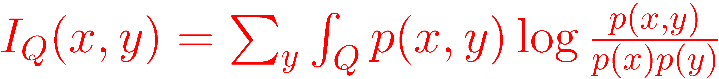
Mutual Information
Gives the amount of variation of y in a local region Q:
Q
+
+
Q
+
-
+
+
+
-
+
+
+
-
  I(x,y) = 0
  Given the label is +, we cannot guess which (x,+) has been chosen (independent).
  I(x,y) = 1
  Given the label is +, we can somehow guess which (x,+) has been chosen.

Slide 44
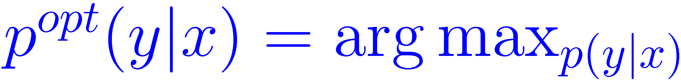
Information Regularization
(Szummer and Jaakkola 2002)
We are after a good conditional P(y|x).
  Belief: Decision boundary lays in low density area.
  P(y|x) must not vary so much in high density area.
Cover the domain with local regions, the resulting maximization problem is:

Slide 45
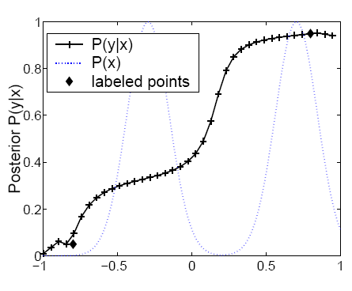
Example
-
+
A two class problem (Szummer&Jaakkola)
Return to smoothness

Slide 46
Outline of the talk
Introduction to Semi-Supervised Learning (SSL)
Classifier based methods
  EM
  Stable mixing of Complete and Incomplete Information
  Co-Training, Yarowsky
Data based methods
  Manifold Regularization
  Harmonic Mixtures
  Information Regularization
SSL for Structured Prediction
Conclusion

Slide 47
Structured Prediction
Example: Part-of-speech tagging:
The representative put chairs on the table.
The input is a complex object as well as its label.
  Input-Output pair (x,y) is composed of simple parts.
  Example: Label-Label and Obs-Label edges:
Observation
Label
DT NN VBD NNS IN DT NN
The
Table
DT NN
NN VBD
DT
NN

Slide 48
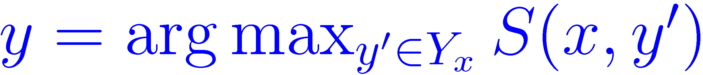
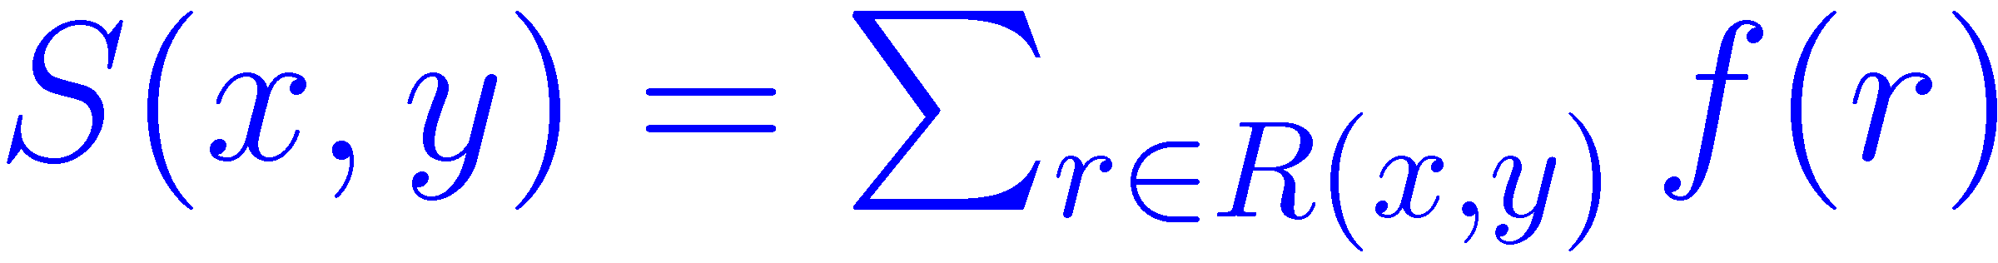
Scoring Function
For a given x, consider the set of all its candidate labelings as Y_{x}.
  How to choose the best label from Y_{x}?
By the help of a scoring function S(x,y):
  Assume S(x,y) can be written as the sum of scores for each simple part:
    R(x,y) the set of simple parts for (x,y).
  How to find f(.)?

Slide 49
Manifold of “simple parts”
(Altun et al 2005)
W
AT NN
-
-
AT The
Construct d-nearest neighbor graph on all parts seen in the sample.
  For unlabeled data, put all parts for each candidate.
Belief: f(.) is smooth on this graph (manifold).

Slide 50
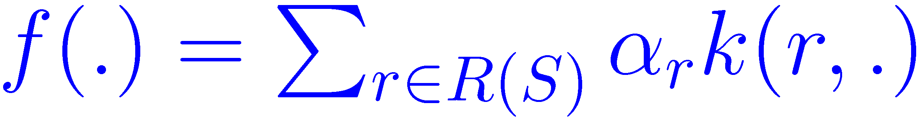
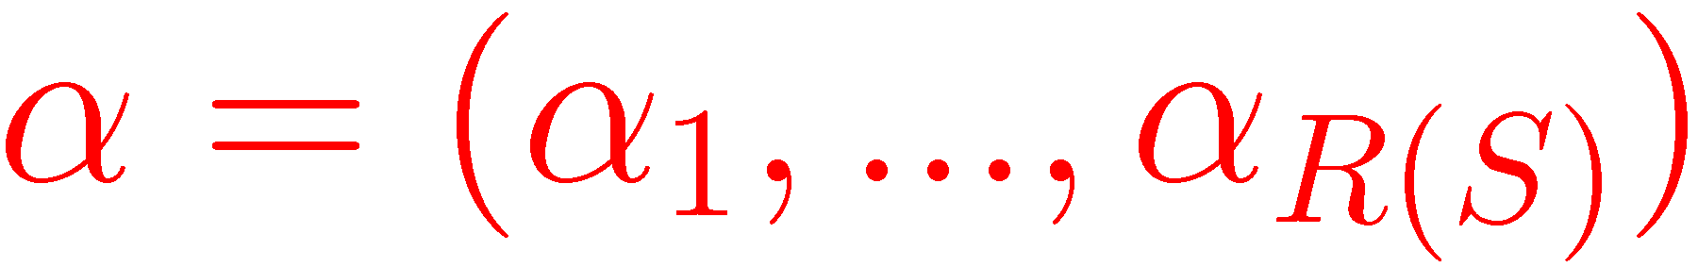
SSL for Structured Labels
The final maximization problem:
The Representer theorem:
  R(S) is all the simple parts of labeled and unlabeled instances in the sample.
  Note that f(.) is related to .
Data dependent
regularization
Fitness to
Labeled data
Function complexity:
Prior belief
Smoothness term:
Unlabeled data

Slide 51


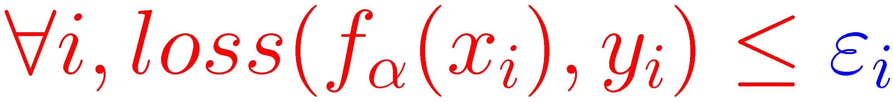
Modified problem
Plugging the form of the best function in the optimization problem gives:
  Where Q is a constant matrix.
  By introducing slack variables :
Subject to

Slide 52
Modified problem(cont’d)
Loss function:
  SVM:
  CRF:
  Note that an α vector gives the f(.) which in turn gives the scoring function S(x,y). We may write S_{α}(x,y).
Subject to
Hamming
distance

Slide 53
Outline of the talk
Introduction to Semi-Supervised Learning (SSL)
Classifier based methods
  EM
  Stable mixing of Complete and Incomplete Information
  Co-Training, Yarowsky
Data based methods
  Manifold Regularization
  Harmonic Mixtures
  Information Regularization
SSL for structured Prediction
Conclusion

Slide 54
Conclusions
We reviewed some important recent works on SSL.
Different learning methods for SSL are based on different assumptions.
  Fulfilling these assumptions is crucial for the success of the methods.
SSL for structured domains is an exciting area for future research.

Slide 55
Thank You

Slide 56
References
Adrian Corduneanu, Stable Mixing of Complete and Incomplete Information, Masters of Science thesis, MIT, 2002.
Kamal Nigam, Andrew McCallum, Sebastian Thrun and Tom Mitchell. Text Classification from Labeled and Unlabeled Documents using EM. Machine Learning, 39(2/3), 2000.
A. Dempster, N. Laird, and D. Rubin. Maximum likelihood from incomplete data via the EM algorithm. Journal of the Royal Statistical Society, Series B, 39 (1), 1977.
D. Yarowsky. Unsupervised Word Sense Disambiguation Rivaling Supervised Methods. In Proceedings of the 33rd Annual Meeting of the ACL, 1995.
A. Blum, and T. Mitchell. Combining Labeled and Unlabeled Data with Co-Training. In Proceedings of the of the COLT, 1998.

Slide 57
References
B. Leskes. The Value of Agreement, A New Boosting Algorithm. In Proceedings of the of the COLT, 2005.
M. Belkin, P. Niyogi, V. Sindhwani. Manifold Regularization: a Geometric Framework for Learning from Examples. University of Chicago CS Technical Report TR-2004-06, 2004..
M. Szummer, and T. Jaakkola. Information regularization with partially labeled data. Proceedings of the NIPS, 2002.
Y. Altun, D. McAllester, and M. Belkin. Maximum Margin Semi-Supervised Learning for Structured Variables. Proceedings of the NIPS, 2005.

Slide 58
Further slides for questions…

Slide 59
Generative models for SSL
Class distributions P(x|y,θ) and class prior P(y|π) are parameterized by θ and π, and used to derive:
θ
π
Unlabeled data gives information about the marginal P(x|θ,π) which is:
x
y
(Seeger)
Unlabeled data can be incorporated naturally!

Slide 60
Discriminative models for SSL
In Discriminative approach P(y|x,θ) and P(x|μ) are directly modeled.
μ
θ
Unlabeled data gives information about μ, and P(y|x) is parameterized by θ.
If μ affects θ then we are done!
  Impossible: θ and μ are independent given unlabeled data.
What is the cure?
  Make μ and θ a priori dependent.
  Input Dependent Regularization
x
y
(Seeger)
μ
θ
x
y

Slide 61
Fisher Information
  Fisher Information matrix:

